Slide 1

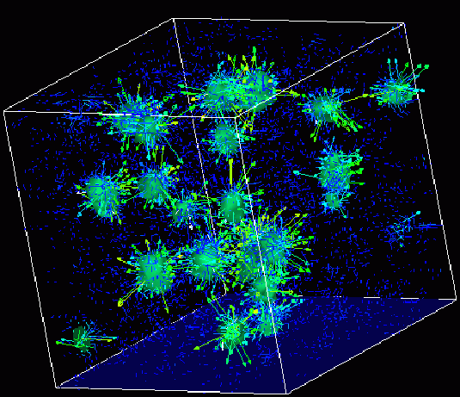

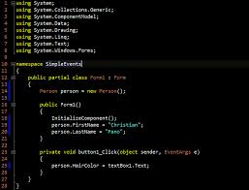
Survey of
Scientific Computing
(SciComp 301)
Dave Biersach
Brookhaven National Laboratory
dbiersach@bnl.gov
Session 10
Matrix Algebra,
Number Theory

Slide 2
Session Goals
Learn how to declare and define a 2D matrix in C++
Implement a function to perform matrix multiplication
Develop recursive code to calculate the determinant of a 2D matrix of any size
Implement Cramer’s rule to solve a system of linear solutions
Verify Goldbach’s Conjecture within a given range by developing a vector of primes

Slide 3
Matrices
A “matrix” in C++ is represented as a vector of vectors
A matrix can hold any number of elements (in each dimension) but all elements must be of the same data type, such as int or double
Matrix elements are accessed by their index numbers, which starts at zero and correspond to each dimension
Matrix nomenclature
In mathematics, a matrix size is written as (Rows x Columns)
In legacy C++ code a matrix (aka an array) is written using commas instead of multiplication crosses, and using square brackets instead of parenthesis: [Row][Column]
Example: the C++ array [5][7] has 5 rows and 7 columns

Slide 4
Matrix Multiplication
When rendering computer graphics, we often need to find the product of two matrices, e.g.
$$\left(\begin{matrix}4 & 5 & 8 \\ 1 & 9 & 7\end{matrix}\right)⋅\left(\begin{matrix}2 & 4 \\ 6 & 1 \\ 5 & 9\end{matrix}\right)= ?$$
There is a standard algorithm to do this multiplication
It involves multiplying each element in the rows of first matrix by each element in the columns of the second matrix

Slide 5
Matrix Multiplication
In order to multiply two matrices together, the number of columns in matrix A must equal the number of rows in matrix B (Cols A = Rows B)
The resulting matrix will have as many rows as there were rows in matrix A, and as many columns as there were columns in matrix B (Rows A x Cols B)

Slide 6
Matrix Multiplication
Example
Matrix A has dimension (2 x 3) = 2 rows, 3 columns
Matrix B has dimension (3 x 2) = 3 rows, 2 columns
$$\left(\begin{matrix}4 & 5 & 8 \\ 1 & 9 & 7\end{matrix}\right)⋅\left(\begin{matrix}2 & 4 \\ 6 & 1 \\ 5 & 9\end{matrix}\right)= ?$$
The inner values must match!
(2 x 3) • (3 x 2)
The outer values will be
the dimension of the final
matrix product!

Slide 7
Matrix Multiplication
Matrix multiplication is not commutative!
If we multiple A x B we will get a different matrix than if we multiply B x A
(3 x 2) • (2 x 3) = result is a (3 x 3) matrix
(2 x 3) • (3 x 2) = result is a (2 x 2) matrix
Welcome to the world of non-commutative algebra
This is very strange – it catches even great physicists by surprise!
This asymmetry is the foundation of the matrix formulation of quantum mechanics

Slide 8
Matrix Multiplication
The algorithm is simple but tedious for A x B = C
Sum the product of every element in each row of matrix A and the corresponding element in each column of matrix B
That sum becomes just one element in new matrix C
Continue this process for all rows in matrix A
Every row in A gets multiplied by every column in B
The resulting matrix will have dimensions (Rows A x Cols B)

Slide 9
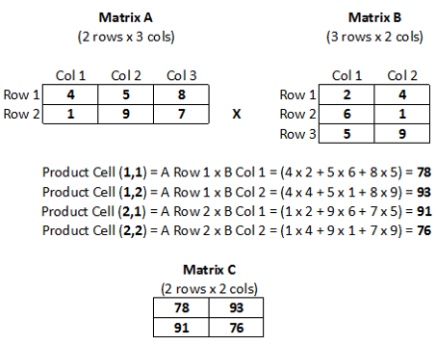
Matrix Multiplication

Slide 10
Matrix Multiplication

Slide 11
Matrix Multiplication

Slide 12
Matrix Multiplication

Slide 13
Matrix Multiplication

Slide 14
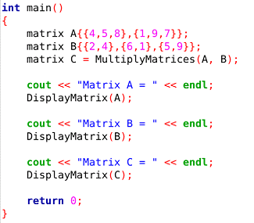
Open Lab 1 – Matrix Multiply
Review the key functions main(), DisplayMatrix(), and MultiplyMatrices()
The code will display the product matrix in row, col format
We can define matrices using the consistent C++ value initialization syntax

Slide 15
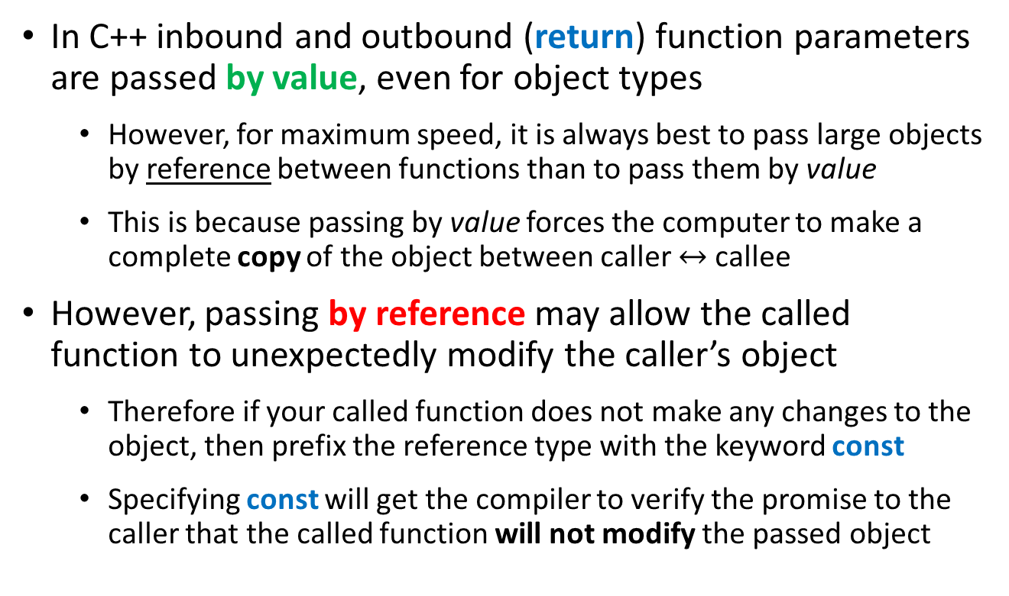
Passing Objects To/From Functions in C++
In C++ inbound and outbound (return) function parameters are passed by value, even for object types
However, for maximum speed, it is always best to pass large objects by reference between functions than to pass them by value
This is because passing by value forces the computer to make a complete copy of the object between caller $↔$ callee
However, passing by reference may allow the called function to unexpectedly modify the caller’s object
Therefore if your called function does not make any changes to the object, then prefix the reference type with the keyword const
Specifying const will get the compiler to verify the promise to the caller that the called function will not modify the passed object

Slide 16
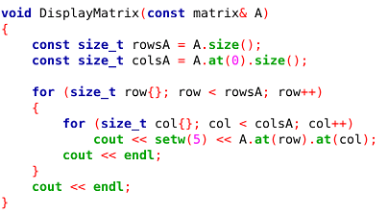
Lab 1 – Matrix Multiply
Matrix A is received as a constant reference
(const matrix&)
Declaring function parameters as a const & is a promise your function will not modify the variable passed to it

Slide 17
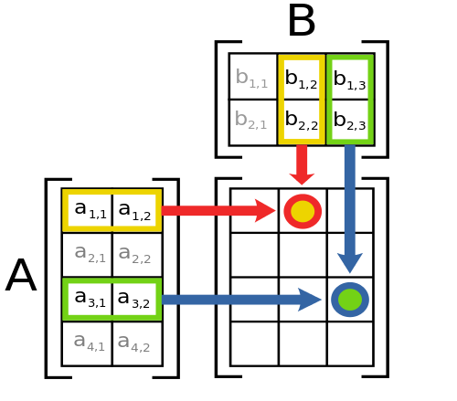
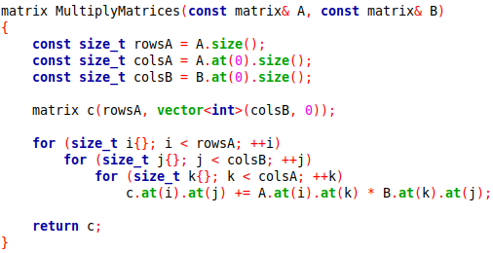
Lab 1 – Matrix Multiply
C++ uses copy elision (rhymes with decision) to avoid duplicating an entire object when returning to the caller
One elision example is NRVO (named return value optimization) where locally scoped variables can be returned directly to the caller without having to be copied

Slide 18
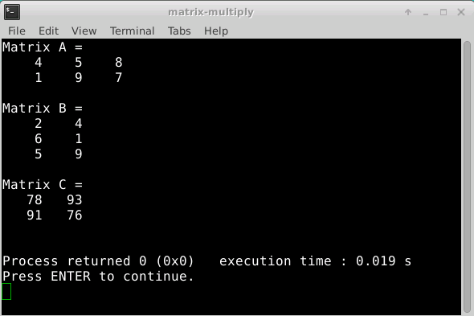
Run Lab 1 – Matrix Multiply

Slide 19
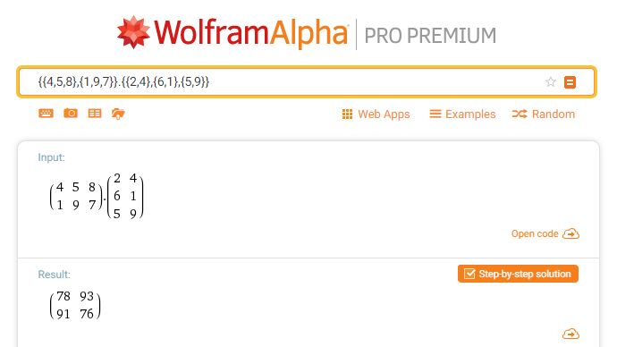
Check Lab 1 - Matrix Multiply

Slide 20

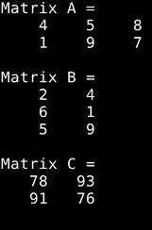
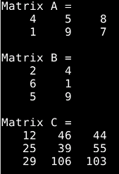




Edit Lab 1 – Matrix Multiply
Change the code to perform $B×A$ – what is the output?
$$A×B$$
$$B×A$$
$$A×B≠B×A$$

Slide 21

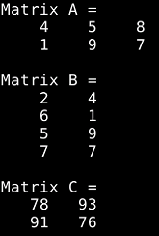
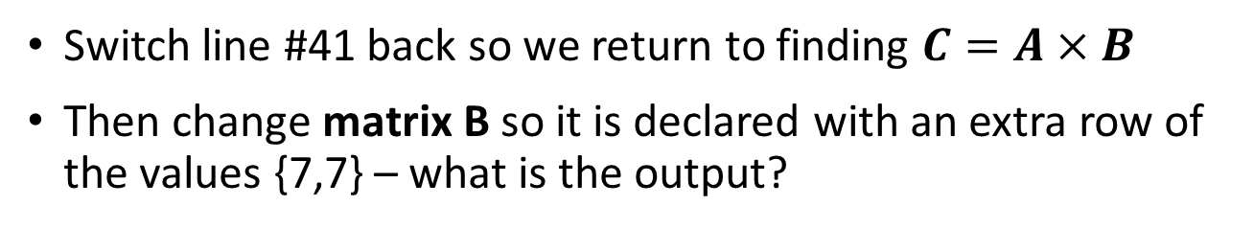
Edit Lab 1 – Matrix Multiply
Switch line #41 back so we return to finding $C=A×B$
Then change matrix B so it is declared with an extra row of the values {7,7} – what is the output?
Is this correct?

Slide 22
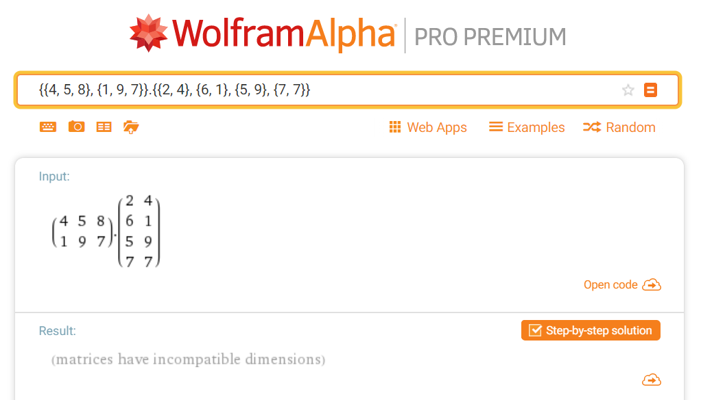

Check Lab 1 – Matrix Multiply
$$\left(2×3\right)∗\left(4×2\right)$$

Slide 23


Edit Lab 1 – Matrix Multiply
Switch line #41 back so we return to finding $C=A×B$
Then change matrix B so it is declared with an extra row of the values {7,7} – what is the output?
$${Cols}_{A}≠{Rows}_{B}→Not valid!$$
How could we strengthen the code to prevent such anomalies?
$$(2×3)∙(4×2)$$
Is this correct?

Slide 24
Determinant of a Matrix
In linear algebra, the determinant is a value that can be computed from the elements of a square matrix
The determinant can be used:
To solve a system of linear equations when those equations are represented by a matrix
To find the Jacobian of the matrix of all first-order partial derivatives of a vector-valued function
To calculate the characteristic polynomial of a matrix which is essential for eigenvalue problems
To express the signed n-dimensional volumes of n-dimensional parallelepipeds in analytic geometry

Slide 25
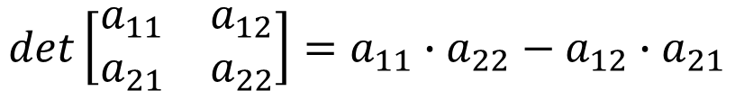
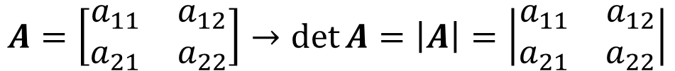
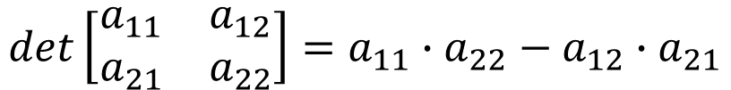
Determinant of a Matrix
Calculating the Determinant of a 2 x 2 Matrix
$$A=\left[\begin{matrix}a_{11} & a_{12} \\ a_{21} & a_{22}\end{matrix}\right]→\det{A}=\left|A\right|=\left|\begin{matrix}a_{11} & a_{12} \\ a_{21} & a_{22}\end{matrix}\right|$$
$$det\left[\begin{matrix}a_{11} & a_{12} \\ a_{21} & a_{22}\end{matrix}\right]=a_{11}∙a_{22}−a_{12}∙a_{21}$$
$$det\left[\begin{matrix}a_{11} & a_{12} \\ a_{21} & a_{22}\end{matrix}\right]=a_{11}∙a_{22}−a_{12}∙a_{21}$$

Slide 26
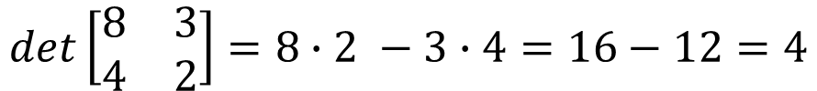
Determinant of a Matrix
Calculating the Determinant of a 2 x 2 Matrix
$$A=\left[\begin{matrix}a_{11} & a_{12} \\ a_{21} & a_{22}\end{matrix}\right]→\det{A}=\left|A\right|=\left|\begin{matrix}a_{11} & a_{12} \\ a_{21} & a_{22}\end{matrix}\right|$$
$$det\left[\begin{matrix}a_{11} & a_{12} \\ a_{21} & a_{22}\end{matrix}\right]=a_{11}∙a_{22}−a_{12}∙a_{21}$$
$$det\left[\begin{matrix}8 & 3 \\ 4 & 2\end{matrix}\right]=8∙2 −3∙4=16−12=4$$

Slide 27
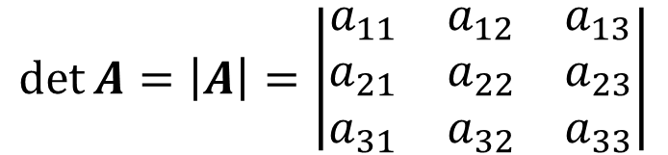
Determinant of a Matrix
Calculating the Determinant of a 3 x 3 Matrix
$$\det{A}=\left|A\right|=\left|\begin{matrix}a_{11} & a_{12} & a_{13} \\ a_{21} & a_{22} & a_{23} \\ a_{31} & a_{32} & a_{33}\end{matrix}\right|$$
$$\left|A\right|=a_{11}\left|\begin{matrix}a_{22} & a_{23} \\ a_{32} & a_{33}\end{matrix}\right|−a_{21}\left|\begin{matrix}a_{12} & a_{13} \\ a_{32} & a_{33}\end{matrix}\right|+a_{31}\left|\begin{matrix}a_{12} & a_{13} \\ a_{22} & a_{23}\end{matrix}\right|$$

Slide 28
Determinant of a Matrix
Calculating the Determinant of a 3 x 3 Matrix
$$\det{A}=\left|A\right|=\left|\begin{matrix}a_{11} & a_{12} & a_{13} \\ a_{21} & a_{22} & a_{23} \\ a_{31} & a_{32} & a_{33}\end{matrix}\right|$$
$$\left|A\right|=a_{11}\left|\begin{matrix}a_{22} & a_{23} \\ a_{32} & a_{33}\end{matrix}\right|−a_{21}\left|\begin{matrix}a_{12} & a_{13} \\ a_{32} & a_{33}\end{matrix}\right|+a_{31}\left|\begin{matrix}a_{12} & a_{13} \\ a_{22} & a_{23}\end{matrix}\right|$$

Slide 29
Determinant of a Matrix
Calculating the Determinant of a 3 x 3 Matrix
$$\det{A}=\left|A\right|=\left|\begin{matrix}a_{11} & a_{12} & a_{13} \\ a_{21} & a_{22} & a_{23} \\ a_{31} & a_{32} & a_{33}\end{matrix}\right|$$
$$\left|A\right|=a_{11}\left|\begin{matrix}a_{22} & a_{23} \\ a_{32} & a_{33}\end{matrix}\right|−a_{21}\left|\begin{matrix}a_{12} & a_{13} \\ a_{32} & a_{33}\end{matrix}\right|+a_{31}\left|\begin{matrix}a_{12} & a_{13} \\ a_{22} & a_{23}\end{matrix}\right|$$

Slide 30
Determinant of a Matrix
Calculating the Determinant of a 3 x 3 Matrix
$$\det{A}=\left|A\right|=\left|\begin{matrix}a_{11} & a_{12} & a_{13} \\ a_{21} & a_{22} & a_{23} \\ a_{31} & a_{32} & a_{33}\end{matrix}\right|$$
$$\left|A\right|=a_{11}\left|\begin{matrix}a_{22} & a_{23} \\ a_{32} & a_{33}\end{matrix}\right|−a_{21}\left|\begin{matrix}a_{12} & a_{13} \\ a_{32} & a_{33}\end{matrix}\right|+a_{31}\left|\begin{matrix}a_{12} & a_{13} \\ a_{22} & a_{23}\end{matrix}\right|$$

Slide 31
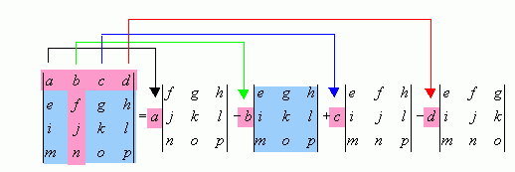
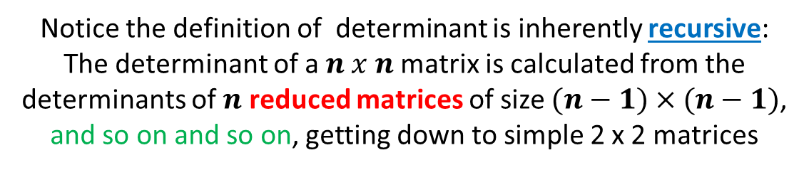
Determinant of a Matrix
Calculating the Determinant of a 4 x 4 Matrix
Notice the definition of determinant is inherently recursive:
The determinant of a $n x n$matrix is calculated from the determinants of $n$ reduced matrices of size $(n−1)×(n−1)$,
and so on and so on, getting down to simple 2 x 2 matrices

Slide 32
Determinant of a Matrix
Calculating the Determinant of a 4 x 4 Matrix
These smaller matrices, where a row and column has been removed, are called the cofactors of the original (larger) matrix
Notice the sign in front of each cofactor alternates from positive (+1) to negative (-1)

Slide 33

Open Lab 2 – Matrix Determinant
Your scientist wants you to write a program to calculate the determinant of a 10 x 10 matrix
Each element in the matrix should be a uniform random integer between -10 and 10 inclusively
Implement the matrix as a C++ vector of vectors
These type aliases declare the same structure

Slide 34
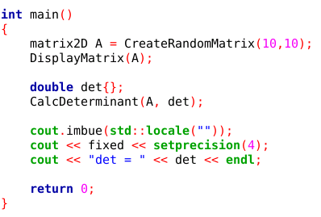
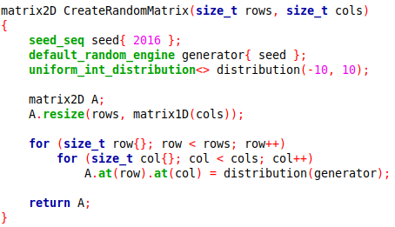
View Lab 2 – Matrix Determinant
Remember a matrix in C++ is a vector of rows where each element is itself a vector of columns

Slide 35
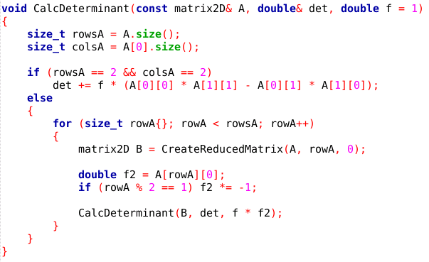
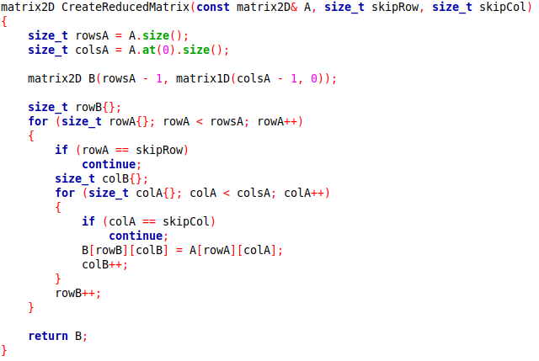
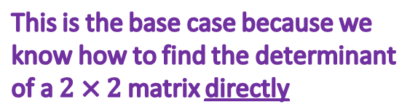
View Lab 2 – Matrix Determinant
We pass the accumulating value of the determinant
This is the base case because we know how to find the determinant of a $2×2$ matrix directly
This is the recursive case as the function calls itself
We use the mod operator (%) to determine the sign of each cofactor matrix

Slide 36
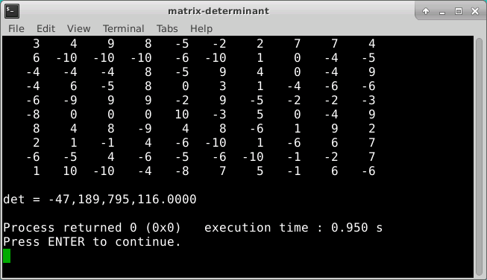
Run Lab 2 – Matrix Determinant

Slide 37
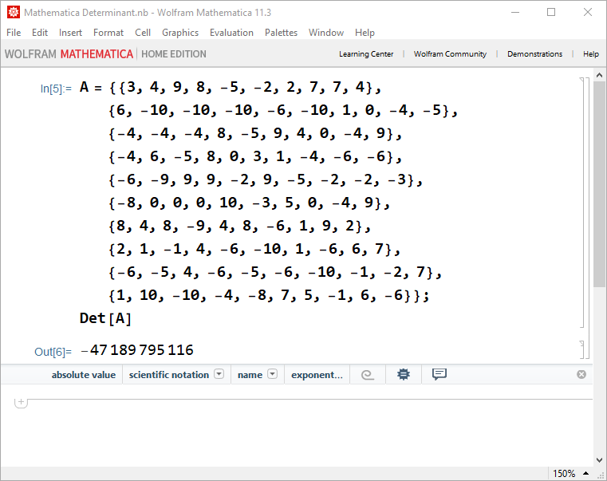
Check Lab 2 – Matrix Determinant

Slide 38








Goal: Solve a System of Linear Equations
Two Equations and Two Unknowns
$$ax+by=c$$
$$dx+ey=f$$
$$ax=c−by$$
$$\frac{d(c−by)}{a}+ey=f$$
$$x=\frac{c−by}{a}$$
$$cd−bdy+aey=af$$
$$y\left(ae−bd\right)=af−cd$$
$$y=\frac{af−cd}{ae−bd}$$

Slide 39





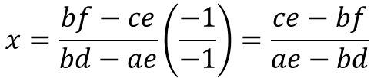
Goal: Solve a System of Linear Equations
Two Equations and Two Unknowns
$$ax+by=c$$
$$dx+ey=f$$
$$by=c−ax$$
$$dx+\frac{e(c−ax)}{b}=f$$
$$y=\frac{c−ax}{b}$$
$$bdx+ce−aex=bf$$
$$x\left(bd−ae\right)=bf−ce$$
$$x=\frac{bf−ce}{bd−ae}\left(\frac{−1}{−1}\right)=\frac{ce−bf}{ae−bd}$$

Slide 40





Goal: Solve a System of Linear Equations
Two Equations and Two Unknowns
$$ax+by=c$$
$$dx+ey=f$$
$$x=\frac{ce−bf}{ae−bd}$$
$$y=\frac{af−cd}{ae−bd}$$
$$\det{C=\left|\begin{matrix}a & b \\ d & e\end{matrix}\right|=ae−bd}$$

Slide 41

Goal: Solve a System of Linear Equations
Two Equations and Two Unknowns
$$ax+by=c$$
$$dx+ey=f$$
$$\det{A=\left|\begin{matrix}c & b \\ f & e\end{matrix}\right|=ce−bf}$$
$$x=\frac{ce−bf}{ae−bd}$$
$$y=\frac{af−cd}{ae−bd}$$
$$\det{C=\left|\begin{matrix}a & b \\ d & e\end{matrix}\right|=ae−bd}$$

Slide 42

Goal: Solve a System of Linear Equations
Two Equations and Two Unknowns
$$ax+by=c$$
$$dx+ey=f$$
$$\det{A=\left|\begin{matrix}c & b \\ f & e\end{matrix}\right|=ce−bf}$$
$$x=\frac{ce−bf}{ae−bd}$$
$$\det{B=\left|\begin{matrix}a & c \\ d & f\end{matrix}\right|=af−cd}$$
$$y=\frac{af−cd}{ae−bd}$$
$$\det{C=\left|\begin{matrix}a & b \\ d & e\end{matrix}\right|=ae−bd}$$

Slide 43


Goal: Solve a System of Linear Equations
Two Equations and Two Unknowns
$$ax+by=c$$
$$dx+ey=f$$
$$\det{A=\left|\begin{matrix}c & b \\ f & e\end{matrix}\right|=ce−bf}$$
$$x=\frac{ce−bf}{ae−bd}$$
$$x=\frac{\left|A\right|}{\left|C\right|}$$
$$\det{B=\left|\begin{matrix}a & c \\ d & f\end{matrix}\right|=af−cd}$$
$$y=\frac{af−cd}{ae−bd}$$
$$y=\frac{\left|B\right|}{\left|C\right|}$$
$$\det{C=\left|\begin{matrix}a & b \\ d & e\end{matrix}\right|=ae−bd}$$

Slide 44
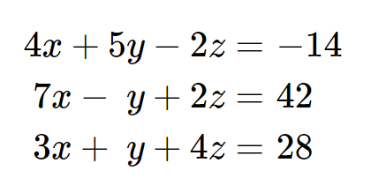
Goal: Solve a System of Linear Equations
Three Equations and Three Unknowns

Slide 45
Open Lab 3 – Cramer’s Rule
Develop a console mode C++ application that uses Cramer’s Rule to solve a system of three linear equations with three unknowns
The code encodes the system of equations as a 2D coefficient matrix and 1D value vector
The code already handles linearly dependent systems
The code displays the equations using standard algebraic formatting rules (aka “pretty print”)
No coefficients of 1, such as 1x + 5y + 32z = 49
No plus signed followed by a negative sign, such as 2x + -5y + 9 = -13
Don’t display an unknown if that term’s coefficient is 0

Slide 46
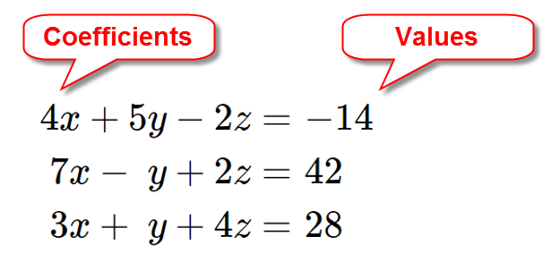
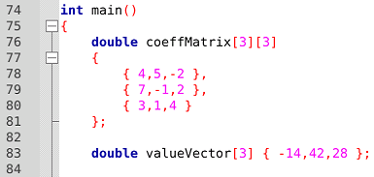
Create a Coefficient Matrix & Value Vector
NOTE: Using [] braces is the legacy way of declaring 2D arrays

Slide 47
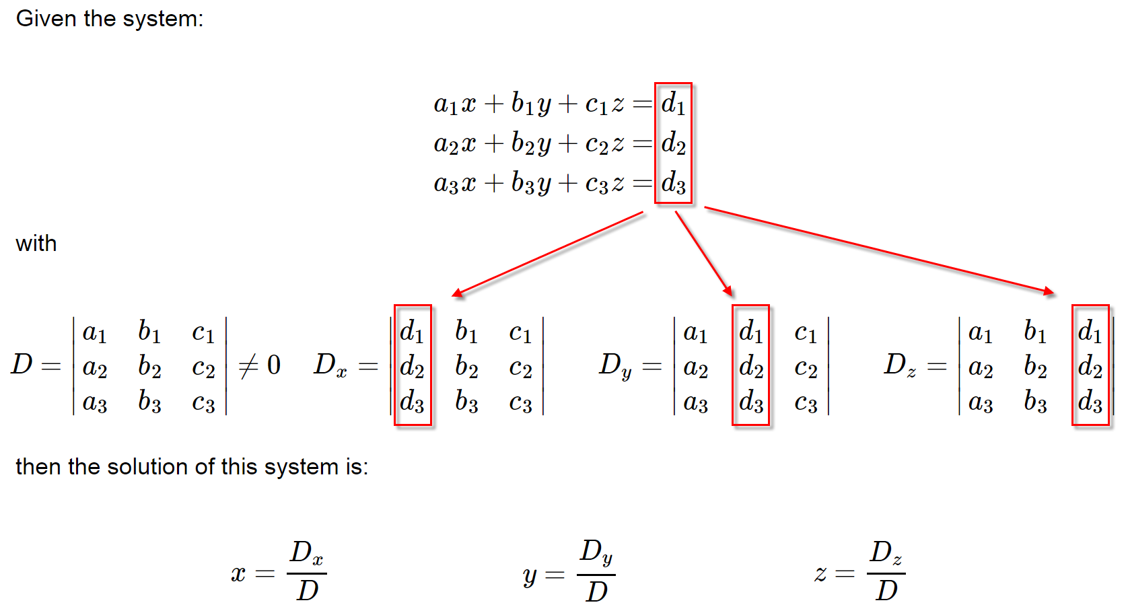
Cramer’s Rule
We create one overlay matrix for each unknown

Slide 48
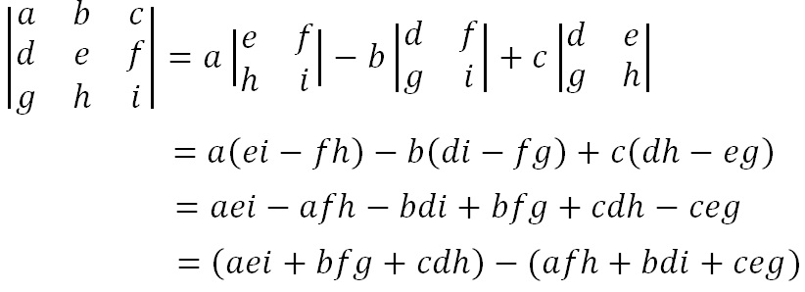
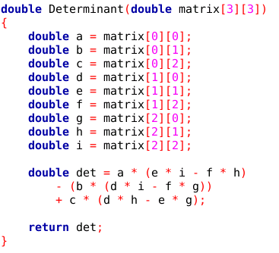
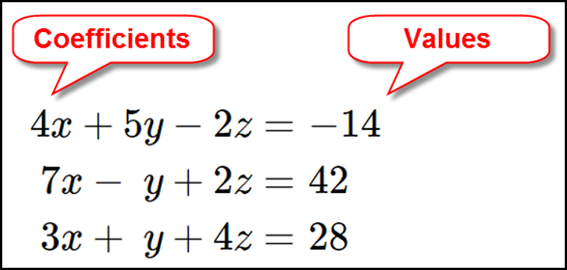
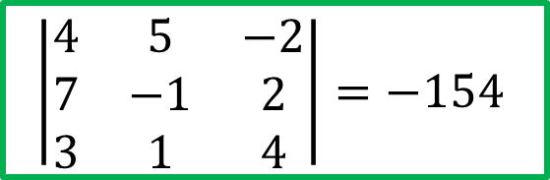
Cramer’s Rule
Calculating the Determinant of a 3 x 3 Matrix
$$\left|\begin{matrix}4 & 5 & −2 \\ 7 & −1 & 2 \\ 3 & 1 & 4\end{matrix}\right|=−154$$
Coefficient Matrix

Slide 49
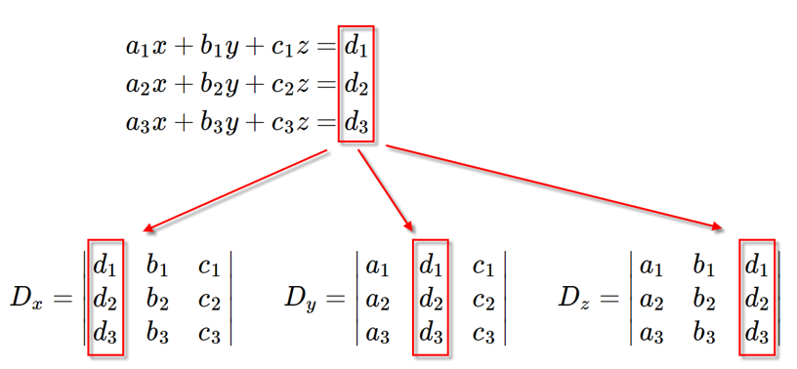
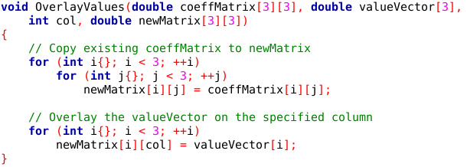
Cramer’s Rule
Overlay the valueVector onto a given column in the coeffMatrix

Slide 50
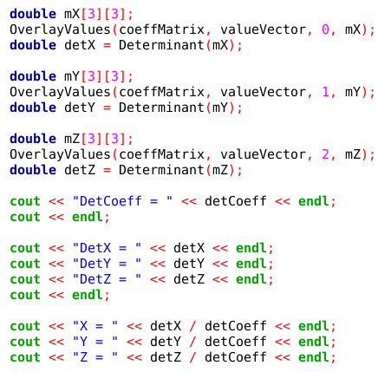
Cramer’s Rule
Create new matrices mX, mY, mZ
All of these calculations could be done in parallel to find each unknown simultaneously

Slide 51
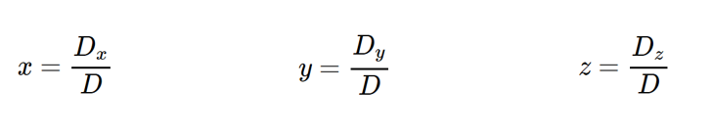
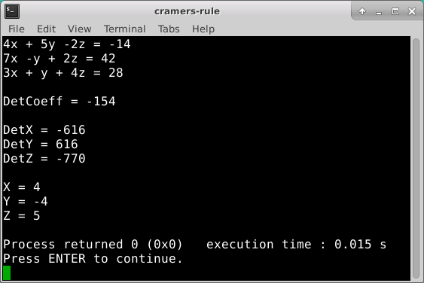
Run Lab 3 - Cramer’s Rule
What does it mean if D = 0?

Slide 52
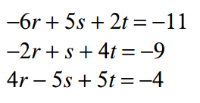
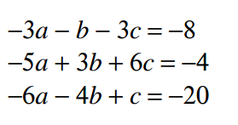
Edit Lab 3 – Cramer’s Rule
Update the main() function to solve these two systems of linear equations:

Slide 53
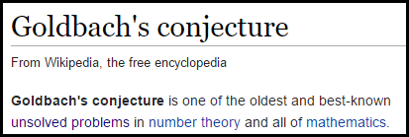
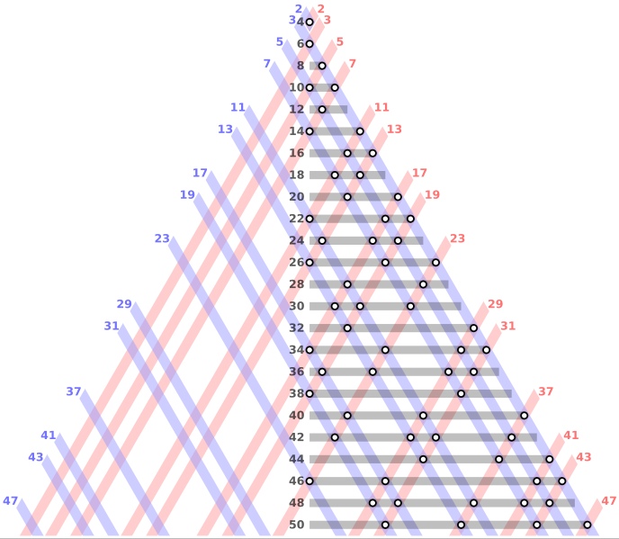

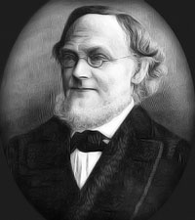
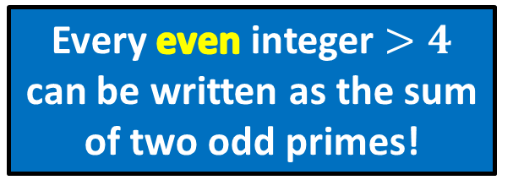
Goldbach’s Conjecture
Every even integer $>4$ can be written as the sum of two odd primes!

Slide 54

Open Lab 4 – Goldbach’s Conjecture
Goldbach’s Conjecture (1742): All even integers $>4$ are the sum of just two odd primes
Develop a console mode C++ application that verifies Goldbach’s Conjecture for all even integers $n≤458$
Create a vector of the first 50 odd primes
Mark every integer that is the sum of any two elements in this primes vector
Display on screen any violations of the conjecture
Despite its simplicity, this remains a conjecture as it has been neither proven nor disproven… we still don’t know!

Slide 55

Lab 4 Goldbach’s Conjecture

Slide 56


Lab 4 Goldbach’s Conjecture
Every even integer $>4$ can be written as the sum of two odd primes!

Slide 57





Run Lab 4 – Goldbach’s Conjecture
How can this be?
Where did we go wrong?
We need to include the first 87 odd primes to cover the range $n≤458$
Verify for all even integers $≤458$

Slide 58


Goldbach’s Conjecture

Slide 59
Now you know…
To multiply two matrices, the # of columns in the first matrix must match the # of rows in the second matrix
The product matrix will have the same # of rows as the first matrix, and the same # of columns as the second matrix
Matrix multiplication is the sum of the element by element products of the rows in the first matrix and the columns in the second matrix
Cramer’s Rule is a step-by-step algorithmic way to solve systems of linear equations without the tedious algebra of back substitution – it uses determinants
This method is easy to run in parallel as each CPU core can calculate a separate unknown at the same time
Goldbach is waiting for you! ☺

